Slide 1

2025 COMMITMENT TO GROWTH
PERSONAL - CHURCH - COMMUNITY
DAILY BIBLE READING/STUDY
DAILY PRAYER COMMITMENT
DAILY LIVING COMMITMENT
  MY WALK + MY TALK = MY WITNESS
WEEKLY FASTING COMMITMENT
WEEKLY BIBLE STUDY
WEEKLY WORSHIP COMMITMENT
WEEKLY GIVING COMMITMENT

Slide 2
Shiloh church bpt through the bible together in 1 year no matter how difficult….your situation is…. there is a way through it!!
(thanking god for grace)
The book of leviticus
sunday - january 19, 2025
Sr. Pastor/teacher – rev carl Mccluster

Slide 3
Flashback to last Sunday
“you always have a choice”
¹⁵ The king of Egypt said to the Hebrew midwives, whose names were Shiphrah and Puah, ¹⁶ “When you are helping the Hebrew women during childbirth on the delivery stool, if you see that the baby is a boy, kill him; but if it is a girl, let her live.”
¹⁷ The midwives, however, feared God and did not do what the king of Egypt had told them to do; they let the boys live. ¹⁸ Then the king of Egypt summoned the midwives and asked them, “Why have you done this? Why have you let the boys live?”
  They were in a ‘situation’ - god showed them the way through
  you always have a choice…god’s way or your way….
    THE BUS/THE MARCH/THE BOYCOTT/THE CHOICE OF WHERE WE SPEND: time - money

Slide 4


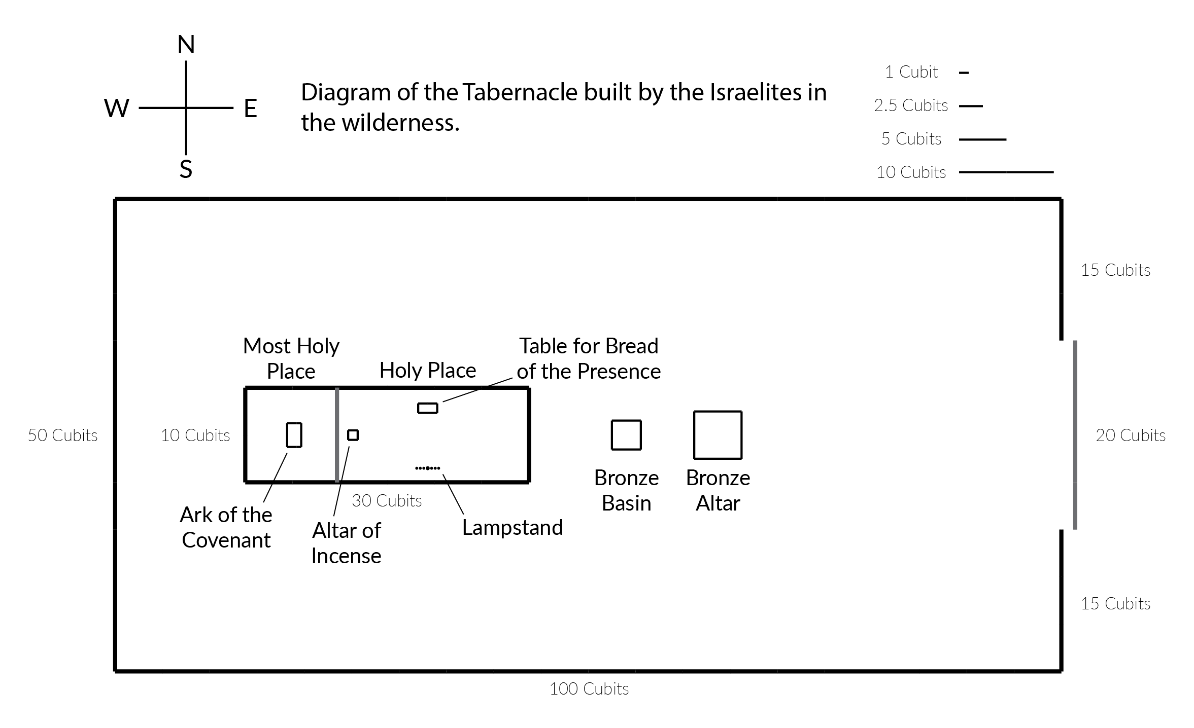
-
1 Cubit = 1 ½ FEET
50 cubits = 75 feet / 100 cubits = 150 feet

Slide 5
Inside the tabernacle
Bronze altar
Bronze basin
Holy place
  Lampstand
  Altar of incense
  Table for bread of presence
Most holy place
  Ark of the covenant

Slide 6
sins of commission & omission
Leviticus 5:1-4a
5 “‘If anyone sins because they do not speak up when they hear a public charge to testify regarding something they have seen or learned about, they will be held responsible.
² “‘If anyone becomes aware that they are guilty—if they unwittingly touch anything ceremonially unclean (whether the carcass of an unclean animal, wild or domestic, or of any unclean creature that moves along the ground) and they are unaware that they have become unclean, but then they come to realize their guilt; ³ or if they touch human uncleanness (anything that would make them unclean) even though they are unaware of it, but then they learn of it and realize their guilt; ⁴ or if anyone thoughtlessly takes an oath to do anything, whether good or evil (in any matter one might carelessly swear about)
  Looking the other way
  “Hidden sin “ – didn’t mean to hit your car…but I did
  Unaware but become aware – clean shirt, don’t clean….find out dirty, clean
  Lying under oath

Slide 7
Sins committed unawares
Leviticus 5:4b-8
even though they are unaware of it, but then they learn of it and realize their guilt— ⁵ when anyone becomes aware that they are guilty in any of these matters, they must confess in what way they have sinned. ⁶ As a penalty for the sin they have committed, they must bring to the Lord a female lamb or goat from the flock as a sin offering^{[a]}; and the priest shall make atonement for them for their sin.
⁷ “‘Anyone who cannot afford a lamb is to bring two doves or two young pigeons to the Lord as a penalty for their sin—one for a sin offering and the other for a burnt offering. ⁸ They are to bring them to the priest, who shall first offer the one for the sin offering.
  Confession & atonement
  Offering what you have

Slide 8
Unintentional sins
Leviticus 5:14-16
¹⁴ The Lord said to Moses: ¹⁵ “When anyone is unfaithful to the Lord by sinning unintentionally in regard to any of the Lord’s holy things, they are to bring to the Lord as a penalty a ram from the flock, one without defect and of the proper value in silver, according to the sanctuary shekel.^{[d]} It is a guilt offering. ¹⁶ They must make restitution for what they have failed to do in regard to the holy things, pay an additional penalty of a fifth of its value and give it all to the priest. The priest will make atonement for them with the ram as a guilt offering, and they will be forgiven.
  Unintentional but guilty (manslaughter)
  Restitution (making good on what was lost)
  Atonement through the guilt offering

Slide 9
Unintentional unknown sins
Leviticus 5:17-19
¹⁷ “If anyone sins and does what is forbidden in any of the Lord’s commands, even though they do not know it, they are guilty and will be held responsible. ¹⁸ They are to bring to the priest as a guilt offering a ram from the flock, one without defect and of the proper value. In this way the priest will make atonement for them for the wrong they have committed unintentionally, and they will be forgiven. ¹⁹ It is a guilt offering; they have been guilty of^{[e]} wrongdoing against the Lord.”
  Manslaughter
  Negligent homicide

Slide 10
god takes it personally
Leviticus 6:1-4
6 ^{[a]}The Lord said to Moses: ² “If anyone sins and is unfaithful to the Lord by deceiving a neighbor about something entrusted to them or left in their care or about something stolen, or if they cheat their neighbor, ³ or if they find lost property and lie about it, or if they swear falsely about any such sin that people may commit— ⁴ when they sin in any of these ways and realize their guilt,
  Sin against neighbor is a sin against god

Slide 11
Did we miss anyone?
Leviticus 6:4b-7
they must return what they have stolen or taken by extortion, or what was entrusted to them, or the lost property they found, ⁵ or whatever it was they swore falsely about. They must make restitution in full, add a fifth of the value to it and give it all to the owner on the day they present their guilt offering. ⁶ And as a penalty they must bring to the priest, that is, to the Lord, their guilt offering, a ram from the flock, one without defect and of the proper value. ⁷ In this way the priest will make atonement for them before the Lord, and they will be forgiven for any of the things they did that made them guilty.”

Slide 12
We have all sinned.. the big question:
Where is the ram?

Slide 13

Behold the lamb
John 3:16
For God so loved the world that he gave his only begotten son…..
That whoever believeth in him shall not perish, but have everlasting life
  Innocence vs. age/value vs. size
  Divine purpose vs. human purpose
  Who is whoever?

Slide 14
The rest of the story!!!
John 3:17
For God did not send his Son into the world to condemn the world, but in order that the world might be saved through him. Whoever believes in him is not condemned
  Divine purpose vs. human purpose
  Who is whoever?

Slide 15
SONG OF DECISION/commitment/ANOINTING
“lord, deliver me”
Le’Andria Johnson - Deliver Me (NEW) 2022

Slide 16
Song of commitment & affirmation
I trust in god!!
Trust In God - Aware Worship ft. Mark Gutierrez (Lyrics)

Slide 17
Invitation
“A Time of Commitment & Filling”
PRAYER – PETITION - PRAISE
PRAY TO GOD FOR
SALVATION – FORGIVENESS – DELIVERANCE - POWER
PETITION GOD FOR
ANOINTING – STRENGTH – WISDOM – DIRECTION INSTRUCTION
PRAISE GOD FOR
HIS ANSWER - HIS MANIFESTATION - HIS ANOINTING
HIS BLESSING

Slide 18
WORSHIP IN GIVING
Personal Commitment
  Tithes
  Offering
  Sacrlificial
  Giving Song – Praise/Bless the Lord with Me
  https://www.youtube.com/watch?v=vBOa1SI8lZU&list=RDvBOa1SI8lZU&start_radio=1&ab_channel=MissYesenia

Slide 19


Welcome & Greeting
Visitors & Friends
WELCOME HOME TO SHILOH
“WHERE CHRIST IS LIFTED UP”

Slide 20

BIBLE DISCOVERY classes
The Book of leviticus
¹⁵ Do your best to present yourself to God as one approved, a worker who does not need to be ashamed and who correctly handles the word of truth - 2nd timothy 2:15
YOU ARE ONLY 25 MINUTES AWAY FROM YOUR SPECIAL GIFTS FOR JOINING BIBLE DISCOVERY CLASS. DON’T FORGET TO PICK UP YOUR TICKET FOR THE GIVEAWAY WHICH WILL BE IMMEDIATELY FOLLOWING CLASS, BEFORE OUR CLOSING SONG AND BENEDICTION

Slide 21
Closing Song of Celebration
“Standing”
https://www.youtube.com/watch?v=hNiKoJgvbtI&ab_channel=ajugofjoe
Benediction & Blessing

Slide 23

Welcome to Faith Gospel Assembly

